Slide 1
Maths Mentor Meeting

Slide 2
Welcome, apologies and introductions

Slide 3
Review Section
Review of Placement 1 (trainee focus)
Review of Placement 1 (mentor focus)
Review of Placement 1 (tutor team focus)

Slide 4
2. Trainee Focus
8 enrolled in September (15 last year)
No returners
None on LOA (1 last year)
0 withdrawals (same as last year)
100% passed assignment 1 (same as last year)
0 below standard in review 1 (same as last year)
0 have secured their first post (1 last year)

Slide 5
2. Trainee Focus (2)
Comments from first visits
Support available for placement 2

Slide 6
3. Mentor Focus- Reflection
Successes
Challenges
Mentor meetings and CCF provision - one approach
Subject specific targets

Slide 7
3. Mentor Focus - Survey
Autumn Term Survey
Mentor support:
To what extent did feedback from subject mentors and host teachers help you to develop as a teacher and grow in you understanding and application of key CCF areas (1,4,7)
Excellent: 83.1%, Good: 15.5% Total E+G: 98.6% Satisfactory: 1.4% Poor: 0% (N=71)
Support, discussion and feedback from your subject mentor:
Excellent: 74.6% Good: 23.9% Total E+G: 98.5% Satisfactory: 1.4% Poor: 0% (N=71)

Slide 8
4. Tutor Team Focus
Action Plan
        CCF 2 Reading list work
        Recruitment work
        Embedding of CCF
Trainee CCF Audit

Slide 9
Course Development
Non-statutory guidance
CCF 2 reading

Slide 10
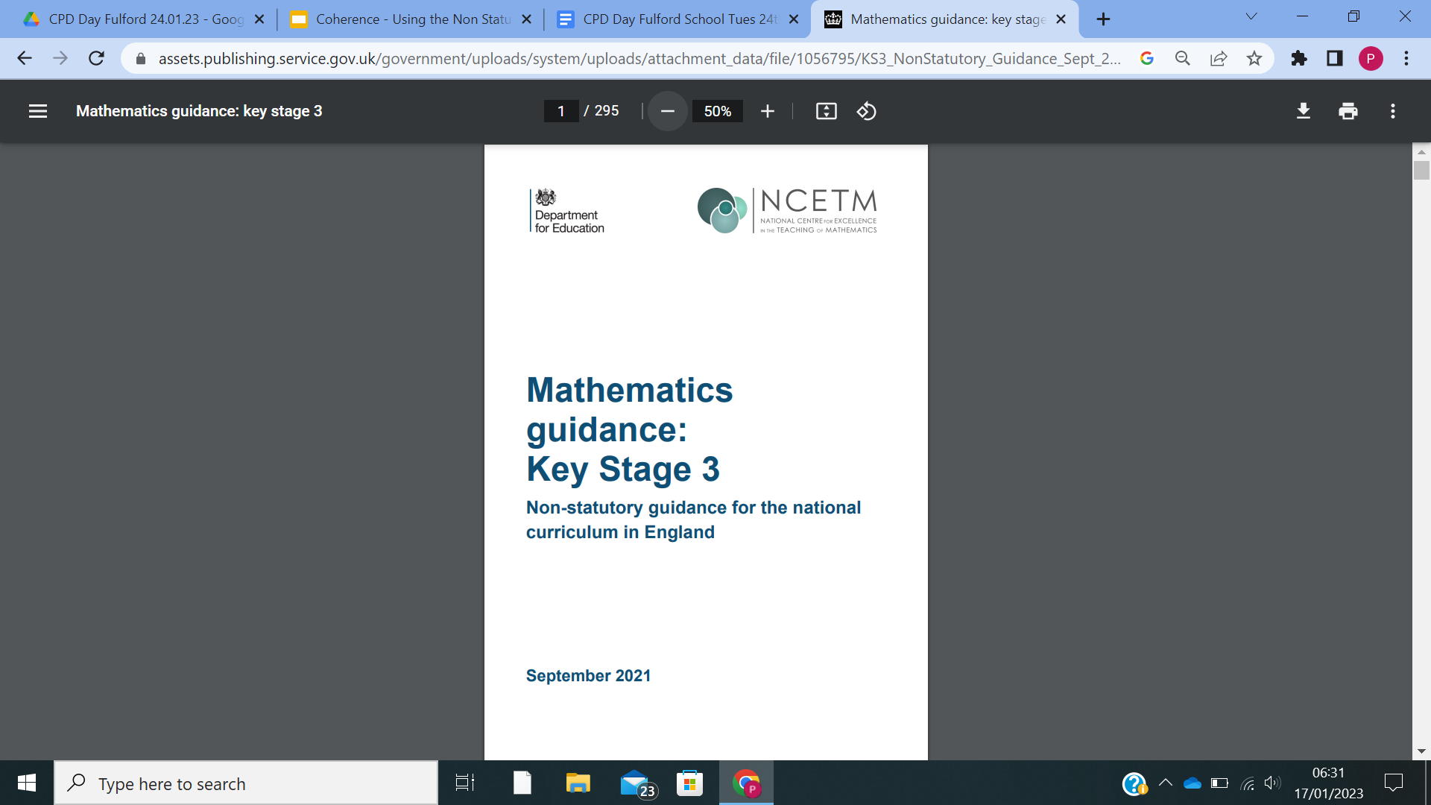
5. Non-statutory guidance
Quick Quiz
When was this document published? (month and year)
How many pages are there?
Bonus Question
How many pages are in the ‘Introduction’ document?

Slide 11
Summary
Summary
Produced to make effective use of the national curriculum to develop secondary school pupils’ mastery of mathematics.
Aims
Bring greater coherence to the national curriculum for mathematics by exemplifying the statutory guidance for Key Stage 3 (DfE, 2013).
Highlights the most important knowledge and understanding developed during Key Stage 3, the connections between different mathematical topics, and how they link back to Key Stage 2 and forward to Key Stage 4.
For selected key ideas, detailed guidance is provided, including common misconceptions; teaching approaches that lead to a deep and connected understanding; and sample questions
This combination of developing fluency and mathematical understanding in tandem will enable students to use their learning accurately, efficiently and flexibly to reason mathematically and solve routine and nonroutine problems, so meeting the aims of the national curriculum.

Slide 12
Discussion
How are schemes of work created in your department?
Is there any opportunity to reflect upon their effectiveness?
Is there any opportunity for collaborative planning?

Slide 13
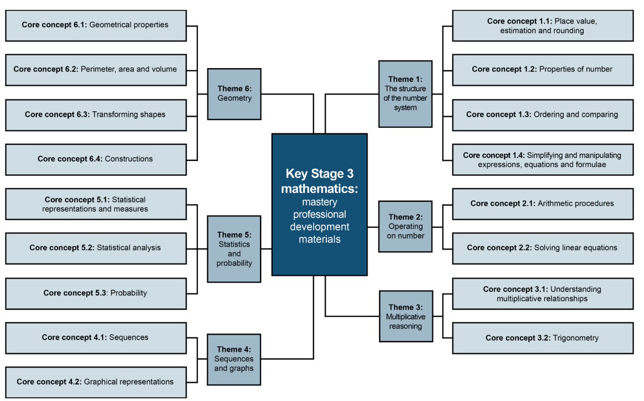
Topic Structure

Slide 14
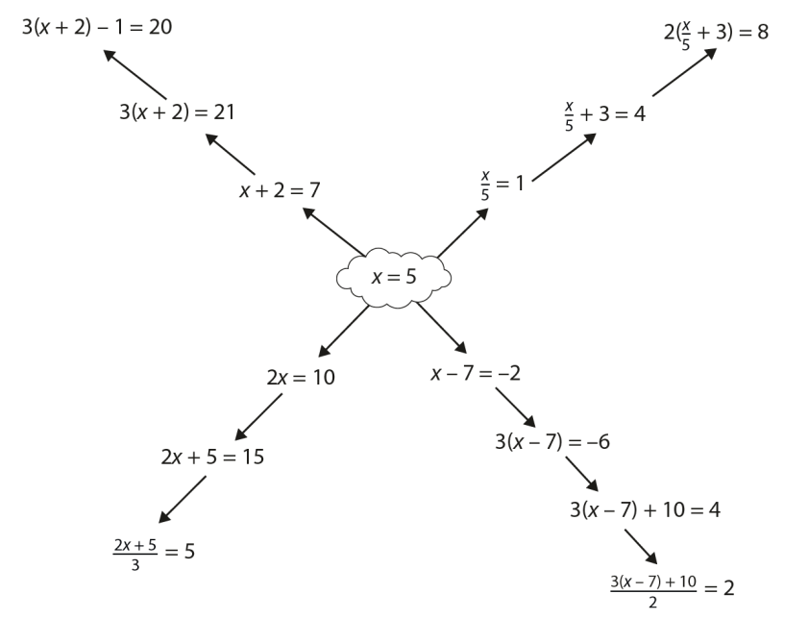
Introducing Linear Equations
What could students do next?

Slide 15
Curriculum Planning
What are the small steps in understanding to get students to the end point of solving linear equations?

Slide 16
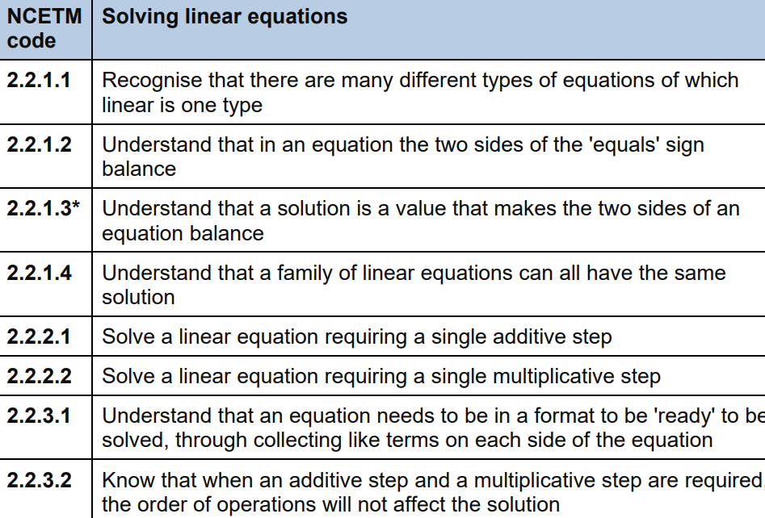
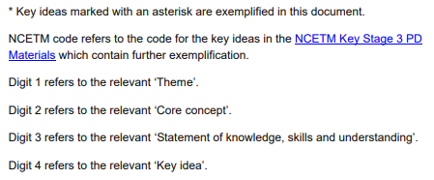
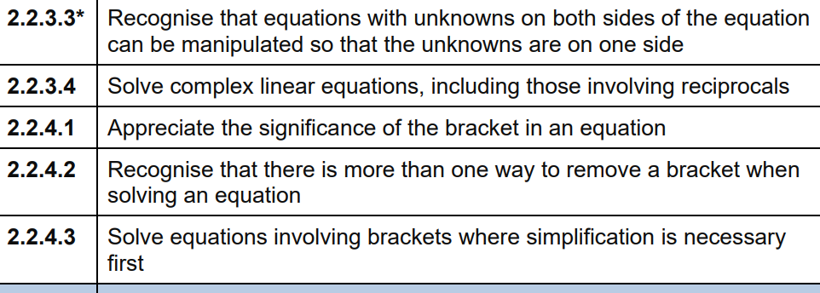
Solving Linear Equations
Notes:
What are the misconceptions and common difficulties with 2.2.3.3? What examples can use to remedy these?

Slide 17
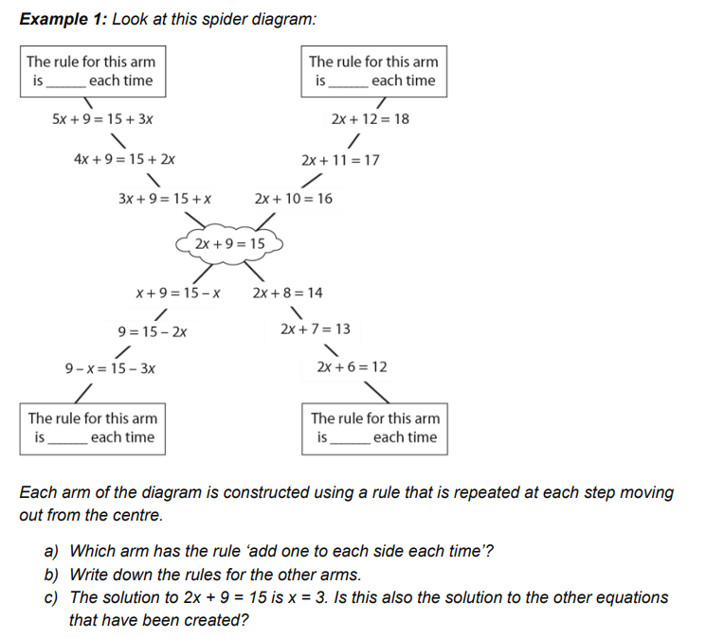
Example Materials 1
Notes:
From page 157
In Example 1, the use of a spider diagram constructed according to given rules gives students an opportunity to understand the impact of making a change to an equation while maintaining the equilibrium. This is not intended to be an efficient strategy for solving equations; rather the intention is to offer insight into the structures that underpin the process of ‘performing the same operation on each side’. A key realisation is that every equation in the diagram has the same solution since each change that has been made maintains the equilibrium.

Slide 18
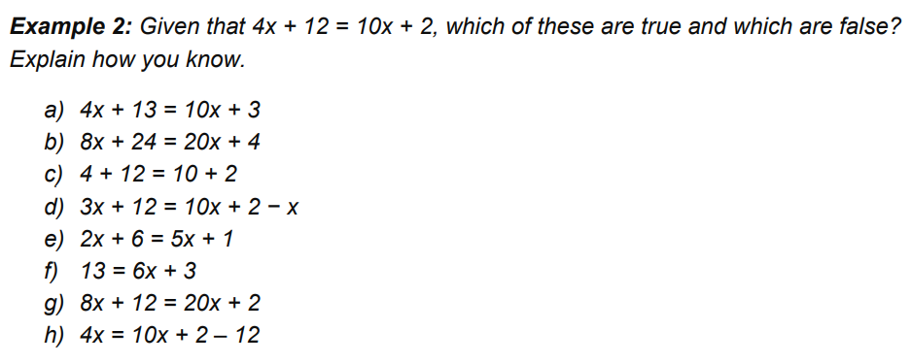
Example Materials 2
Notes:
Example 2 considers how to correctly transform equations whilst maintaining equality. There are only two equations here that are not a correct transformation of the given equation – parts c and g. Some of the transformations offered – parts d and h – have not been simplified, and this may be a useful discussion point for students. Although the intention of this task is not to focus on processes for solving an equation, a useful prompt might be to ask which of the valid transformations students think moves closer to a solution and why. The two non-examples used in this example are chosen to highlight particular misconceptions. In part c, the ‘x’s have been ‘taken away’ (they have been removed from the equation rather than being subtracted). In part g, the coefficient of the x has been doubled on each side, but the constant term has not been changed.

Slide 19
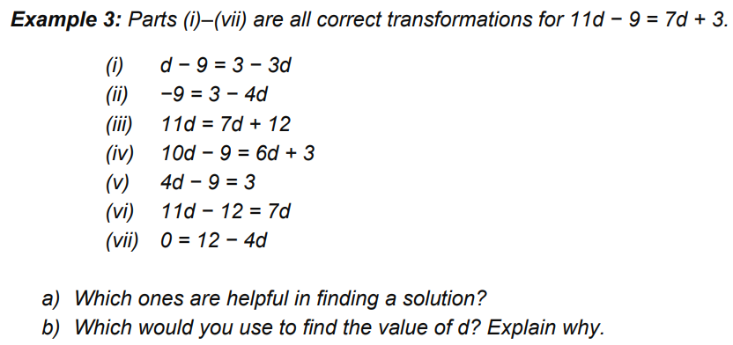
Example Materials 3
Notes:
In Example 3, students are offered a range of correct manipulations, allowing them to focus on making a decision about which manipulations will move them closer to solving the equation. A useful discussion might be had around what transformation has taken place to change the original equation to each of the examples (with the exception of part vii, each example is the result of just one change), but the key idea here is that some of these transformations – parts ii, iii, v, vi and perhaps vii – reduce the number of terms in the equation while maintaining the equality, and so move closer to a solution. This example also offers an opportunity to discuss the order in which equations like this are solved: students will need to decide whether to manipulate the constant terms first; as in parts iii and vi; or to deal with the unknown first, as in parts ii and v.

Slide 20
6. CCF 2 Reading
CCF reading list
What?
How?
Notes:
How much reading do you do with your trainee? What would support you to do more?

Slide 21
6. CCF 2 Reading - task
7 recommendations
How could this link to school based work?
How can we link this to uni based work?

Slide 22
Looking Forward Section
Overview of Placement 2

Slide 23
7. Overview of Placement 2
Key dates Programme
Assignment 3 Task
Professional Enrichment

Slide 24
OFSTED Preparation
Our vision and curriculum

Slide 25
8. Our Vision and Curriculum
Vision Statement
Briefing sheet

Slide 26
AOB

